Slide 1

Group 3
Software Manager: Dirk Thieme
Hardware Manager: Erik Manis
Project Controller: Mohammed Ansari

Slide 2
Rover Mini Project
Summary: Use the BASYS 3 board’s built-in switches to control the speed and direction of the motors inside of a rover based on which switch is pulled.
Goals: Build a better understanding of the board, the h-bridge, and the Verilog software.

Slide 3
Last Week's Tasks
Soldering Tutorial
Mohammed and Erik finished
Dirk is going in tomorrow
We have gotten some parts in
Get a Workbench
We have workbench 1
Get an H-bridge
Choose a circuit simulator
We familiarized ourselves with LTspice
Watch Verilog tutorials
Set up a GitLab repo to manage all our project files and information

Slide 4
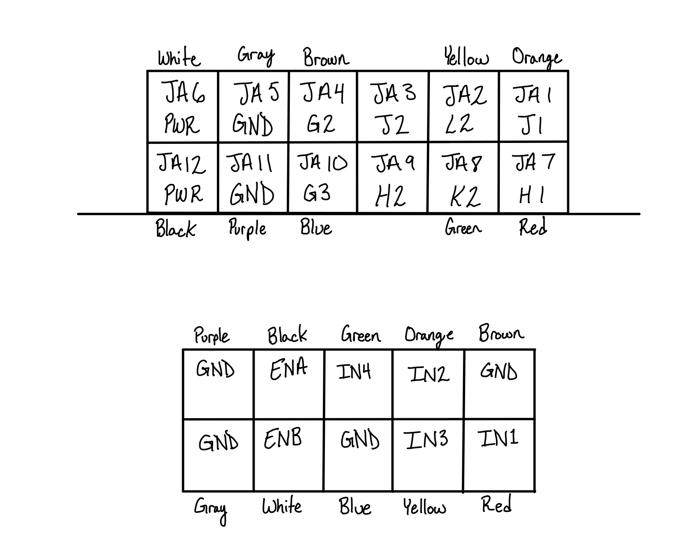
Hardware Update
PMOD

Slide 5
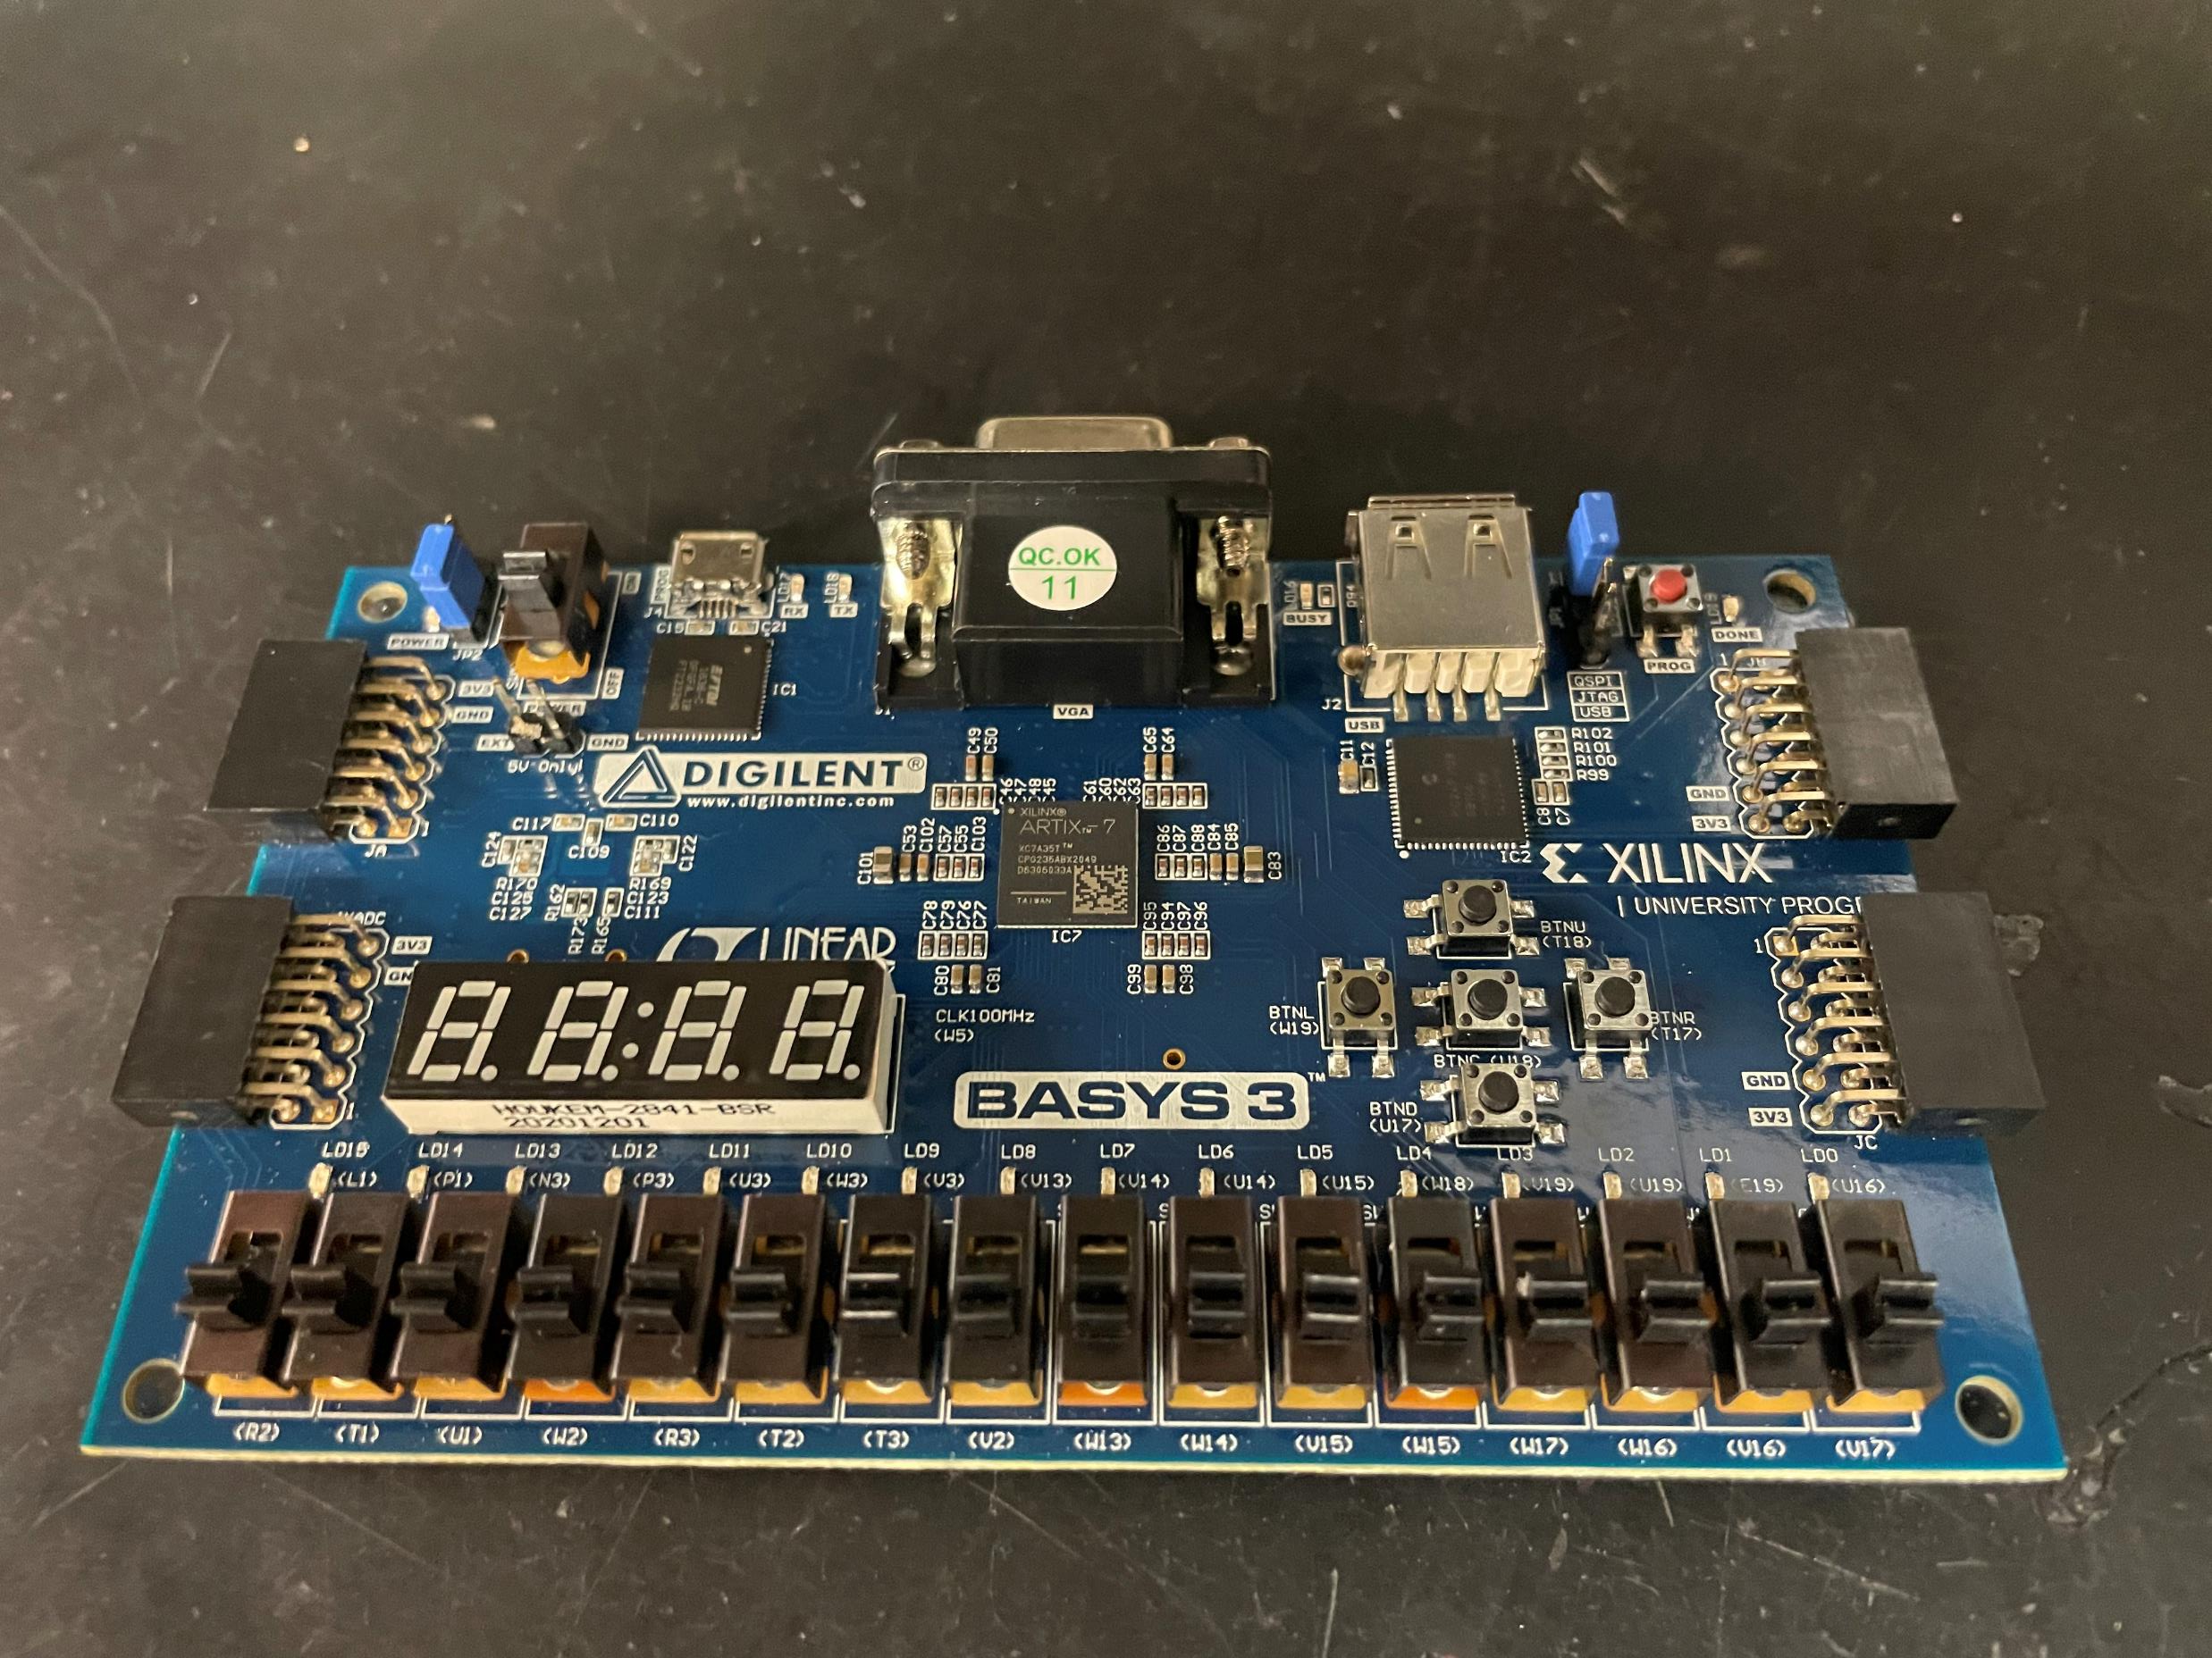
Hardware Update
BASYS 3 Board

Slide 6
Hardware Update
We obtained all the parts necessary for the rover and we are going to start making an enclosure for the boards, so they are not bumped or damaged.

Slide 7
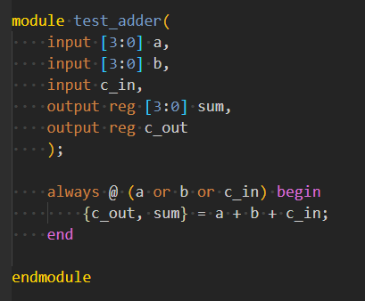
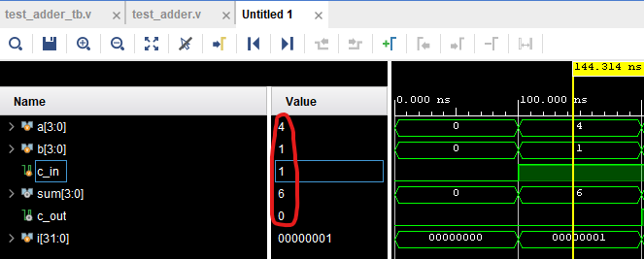
Software Update
We ran a couple of test programs on Vivado to refamiliarize ourselves with Verilog and this new IDE.

Slide 8
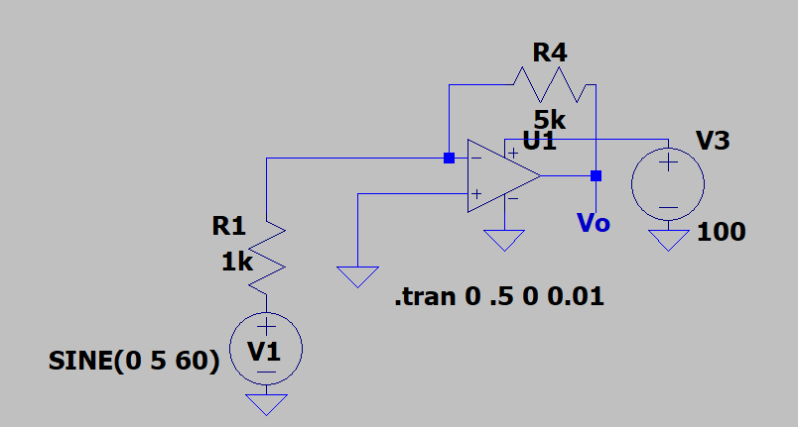
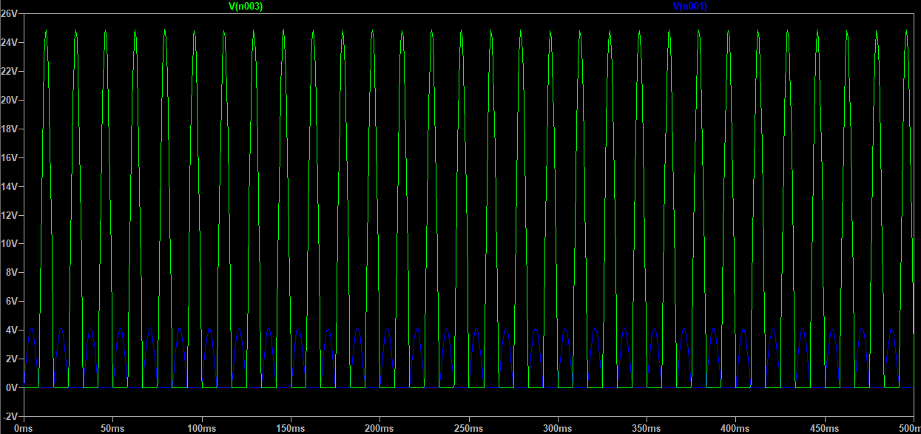
Software Update
Installed and practiced using LTspice to familiarize ourselves with the program and how to design some circuits.

Slide 9
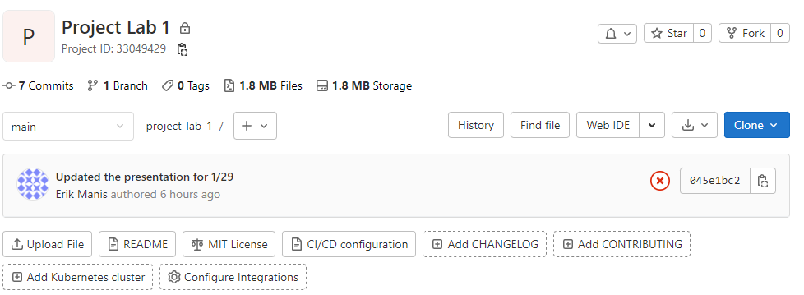
Software Update
We decided to switch from Microsoft OneDrive to GitLab as we were having issues syncing data.

Slide 10
Gantt

Slide 11
Overall Budget

Slide 12
Labor Costs

Slide 13
Material Costs

Slide 14
Next Week's Tasks
Finalize a rover design
Get a running test bench
Get CPR certifications
Testing the rover for defects in software or hardware

Slide 15

Questions
Software Manager: Dirk Thieme
Hardware Manager: Erik Manis
Project Controller: Mohammed Ansari
This Photo by Unknown author is licensed under CC BY.

